Slide 1
Linear Regression

Slide 2
Linear Regression
Linear regression is a type of supervised machine learning algorithm that computes the linear relationship between the dependent variable and one or more independent features by fitting a linear equation to observed data.
When there is only one independent feature, it is known as Simple Linear Regression, and when there are more than one feature, it is known as Multiple Linear Regression.
Similarly, when there is only one dependent variable, it is considered Univariate Linear Regression, while when there are more than one dependent variables, it is known as Multivariate Regression.

Slide 3
Why Linear Regression is Important?
Its simplicity is a virtue, as linear regression is transparent, easy to implement, and serves as a foundational concept for more complex algorithms.
Linear regression is not merely a predictive tool; it forms the basis for various advanced models. Techniques like regularization and support vector machines draw inspiration from linear regression, expanding its utility.
For example: predicting salary based on years of experience, predicting exam score based on study hours, predicting resale price based on vehicle age.

Slide 4
Types of Linear Regression
There are two main types of linear regression:
Simple Linear Regression
Y=mX+b
Multiple Linear Regression
Y=m1X1+m2X2…..mnXn+b

Slide 5
Simple Linear Regression
Equation of Linear Regression Y=mX+b
Y is dependent variable
X represents independent variable
m is the slope of the line that how much Y changes for a unit change in X.
b is the intercept that is the value of Y when X is 0.
The goal of the algorithm is to find the best Fit Line equation that can predict the values based on the independent variables.

Slide 6
Simple Linear Regression
For understanding we are taking an Example of Predicting Pizza prices
Diameter X in inches (pizza size) | Price Y in Dollars
8 | 10
10 | 13
12 | 16
20 | ??

Slide 7
Simple Linear Regression
To compute price of pizza having diameter 20 we have to calculate m and b using model equation y=mX+b
Calculate m=sum of product of deviations/sum of square of deviation for X
Calculate b=mean of Y-(m*mean of X)

Slide 8
Simple Linear Regression
Diameter X in inches (pizza size) | Price Y in Dollars | Mean(X) | Mean(Y) | Deviation(X) | Deviation(Y) | Product of deviation | Sum of product of deviation | Square of deviation for X
8 | 10 | 10 | 13 | -2 | -3 | 6 | 12 | 4
10 | 13 |  |  | 0 | 0 | 0 |  | 0
12 | 16 |  |  | 2 | 3 | 6 |  | 4
m=12/8=>1.5 (mean if we place X value as 1 then Y will be change with 1.5)
b=13-(1.5*10) =>-2
So to predict Y with 20 size put values
Y=1.5*20+(-2) =>28 dollars

Slide 9
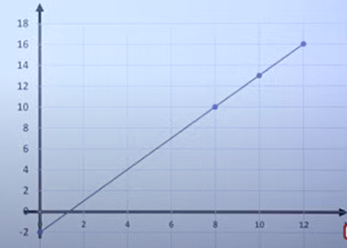


Simple Linear Regression

